Slide 1
System Support Mapper (SSM)
Steve Chall
Data Science and Analytics meeting
May 9, 2018

Slide 2
SSM: Primary contributors
Kristen Hassmiller Lich, Associate Professor, Health Policy and Management, Gillings School of Global Public Health
Steve Chall, RENCI
Jeff Terrell, (co-founder of startup Allometrics, recently appointed CS Professor of the Practice at UNC-CH)

Slide 3
System Support Mapping: Overview
Organize qualitative data
Tuned for health management applications
Primary tool for data acquisition is a directed graph, with some specialized features

Slide 4
SSM is typically used for determining available resources and needs assessment
S. Arangdad (NCSU post-doc), Training and technical assistance project to support title X family planning program, in development. (federal grant program)
D. Befus, A Systems Thinking, Community-Based Exploration of Health Equity and Agency: Women’s Migraine as a Paradigmatic Case, Ph.D. dissertation, Duke School of Nursing, 2017.
D. Befus (now a Wake Forest post-doc), et al, A qualitative, systems thinking approach to study self-management in women with migraine, Nursing Research (in press).
K. Borrup, Informing Action Toward Integrated Mental Health Practice in the Pediatric Primary Care Setting in Connecticut, Ph.D. Dissertation, University of Illinois at Chicago, School of Public Health, 2018.
L. Calancie (UNC post-doc), S. Chall, et al, System Support Mapping – A novel systems science method applied to assess the needs of the Maternal and Child Health Title V workforce, in development. (federal grant program)
R. Karmali, Running out of options: Is access to non-pharmacologic pain management treatments linked to opioid prescriptions? Ph.D. Dissertation, UNC School of Public Health, 2018.

Slide 5
Data acquisition

Slide 7
Web site: http://syssci.renci.org/ssm
Runs on a RENCI server
Front end: D3.js/JavaScript, HTML, CSS
Clojure back end
PostgreSQL
JSON output

Slide 8
Graph specializations
Labeled rings: Role/Identity, Responsibilities, Needs for each responsibility, available Resources, Wishes
Conventions for shape and color for nodes within each ring (subsequent analysis depends on these conventions, shape in particular)
Edges may be color-coded to indicate efficacy of what the target node represents
Other capabilities (rarely used in practice): label edges, attach links and notes (tool tips) to nodes, different edge thicknesses and styles, other ring configurations (including none)

Slide 9
SSM variations
Superficial UI changes: different ring color scheme and labeling conventions: http://syssci.renci.org/ssm_beh/
UI experiment: http://syssci.renci.org/force-directed-map/
Level 2 Data Security, for Ruchir Karmali’s HIPAA-sensitive research (runs in secure UNC CloudApps VM with Shibboleth authorization/authentication): https://ssm.cloudapps.unc.edu/

Slide 10
Wizard
Many users find ssm’s graphical UI to be too difficult (requires Photoshop- or Illustrator-type skills)
Hence, a wizard that provides a text-based interface: it asks you questions and creates a graph based on your answers.
Each kind of wizard is highly specific to a particular audience. Its focus and concerns will be very different for different users: say, for a Title V MCH state administrator as opposed to the single parent of a child with autism.

Slide 11
Wizard[s]
The text is embedded in a YAML file so that one single wizard website can be adapted to multiple audiences by invoking similarly-formatted files with different content through different URLs
For example, these two wizards are the same except for their YAML text:
http://syssci.renci.org/ssm-wizard/?module=CaregiversCYSHCN
http://syssci.renci.org/ssm-wizard/?module=TitleVWorkforce

Slide 12
Wizards
However, we began to require wizards with more fundamental specializations that mere text changes could provide, e.g., different UIs for grabbing detailed audience-specific demographic info, text entry completions. Thus:
http://syssci.renci.org/ssm-wizard-mental-health-in-schools/
http://syssci.renci.org/ssm-wizard-TitleX/
http://syssci.renci.org/ssm-wizard-TitleV/
etc.

Slide 13
Data processing
An R script converts a set of SSMs into adjacency graphs in TSV format
Also provides lists of node texts, organized by ring, to be sorted with reference to codes
A code is a category or generalization that applies to a set of nodes with related text content

Slide 14
Sort utility
http://syssci.renci.org/sort/
Text and JSON output

Slide 15
Further processing
R script adds codes to corresponding rows for all TSV adjacency matrix files, in preparation for the following:
Python scripts provide adjacency graphs and other representations of relationships between codes, and between codes and their associated node texts:
Code Matrix (CM): rows and cols are codes, elements are connections
3cols: to, from, value
Code Presence Matrix (CPM): rows are SSM files, cols are codes. How often does each code show up in each SSM?
Coded System Support Map: switch between original node text and codes.

Slide 16
Future work
Hierarchical coding: clusters of codes
Refactor data processing sequence
More sophisticated filtering of data (text) input
Additional vis and analysis tools
Improved usability for SSM and Wizard websites
NLP applied to coding, i.e., automated coding

Slide 17
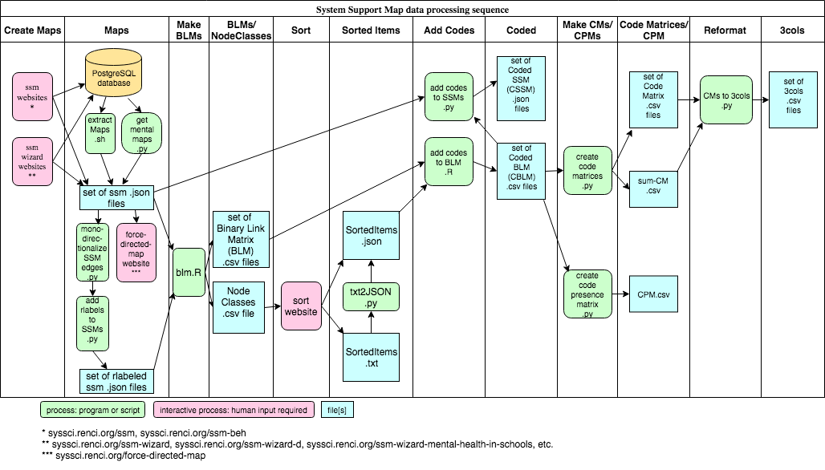

Slide 18
These slides are available, along with other System Support Mapping documentation, at
https://github.com/steve9000gi/ssm-documentation/.

